Slide 1
W 207– Applied Machine Learning
Cornelia Ilin, PhD
School of Information
UC Berkeley
Introduction

Slide 2
About me
Lecturer in the School of Information at UC Berkley
Research Scientist at Stanford University
Postdoc in the School of Information at UC Berkeley
PhD in Applied Economics (UW Madison)
Research at the intersection of health and environment

Slide 3
About you
Undergraduate major
Current job (if any)
Why Data Science at UC Berkeley?
Why W207?

Slide 4
Course websites
Lecture and Lab material will be uploaded on the course website: https://corneliailin.github.io/datasci_w207_summer2022/
Grades will be posted on ISVC: https://learn.datascience.berkeley.edu/

Slide 5
Live sessions organization
Each session is 90 minutes
30 minutes Q&A related to the topic of the week
30 minutes Code demonstration
30 minutes Breakout room exercises

Slide 6
Today’s learning objectives
General concepts of Machine Learning (ML)
Roadmap for building ML systems
Review of Numpy arrays
Introduction to TensorFlow

Slide 7
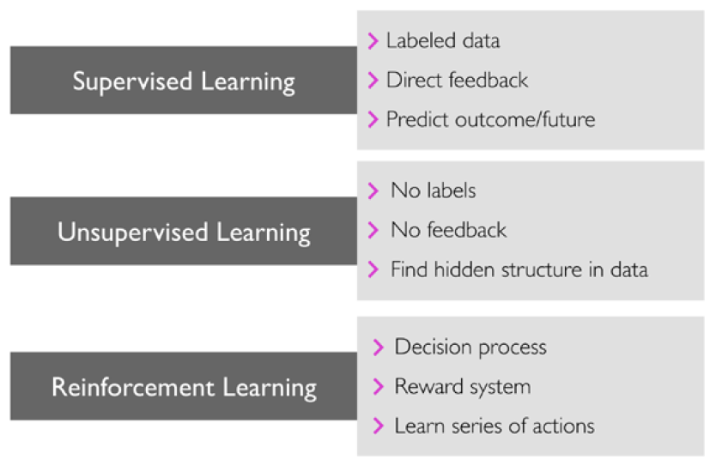
General concepts of ML
Q1: Name and explain the 3 types of ML supervision
Image source: S. Raschka and V. Mirjalili, Python Machine Learning

Slide 8
General concepts of ML
Q2: Can you make predictions about the future using ML? Provide an example.
Yes! The main goal in supervised learning is to learn a model from labeled training data that allows us to make predictions about unseen data
Example: see Introduction.ipynb

Slide 9
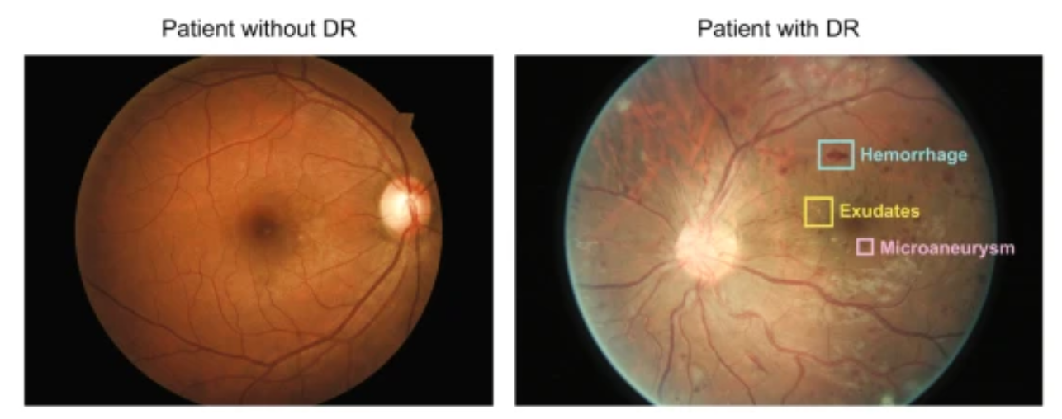
General concepts of ML
Q2: What is the goal of classification in ML? Provide an example.
Classification is a subcategory of supervised learning where the goal is to predict the categorical class labels of new instances, based on past observations.
Example: Diabetic retinopathy fundus image classification: refer a patient to a doctor or not.
Image source: https://www.nature.com/articles/s41746-019-0172-3

Slide 10
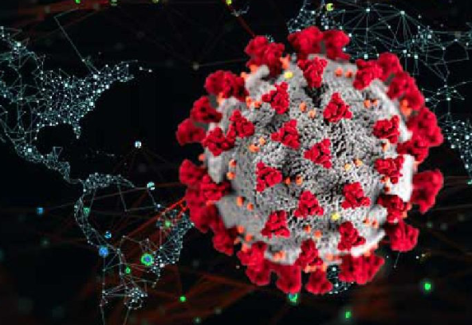
General concepts of ML
Q3: What is the goal of regression analysis in ML? Provide an example.
The task of classification is to assign categorical labels. Regression analysis is a subcategory of supervised learning and can be used to predict continuous outcomes.
Example: predict number of COVID-19 cases

Slide 11
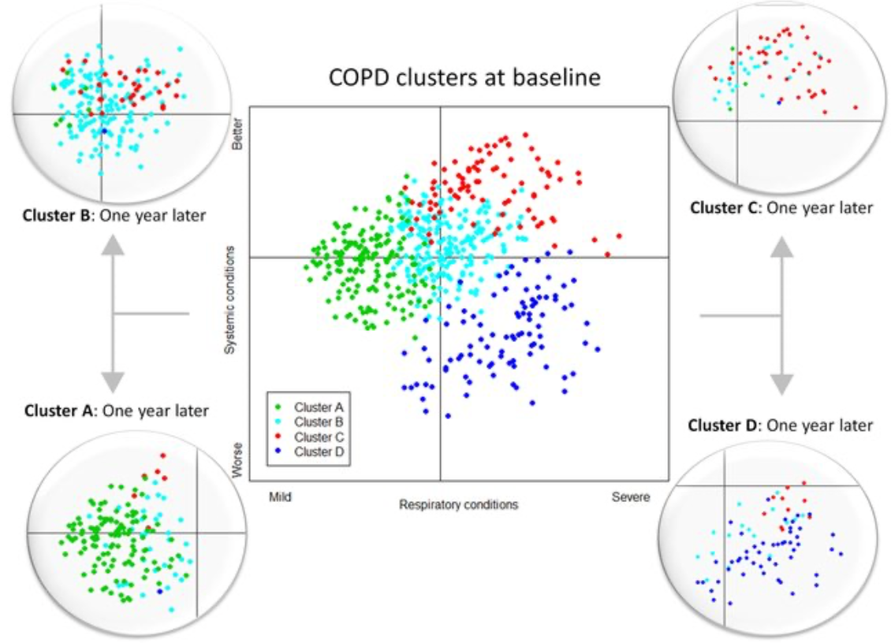
General concepts of ML
Q4: True or False? Clustering is a technique used for structuring information and deriving meaningful relationships from data.
True, it’s an unsupervised learning technique used to find subgroups in data.
Example: discover patient groups based on their diagnosis history in order to develop distinct treatment plans.
Image source: https://www.researchgate.net/publication/307969853_Chronic_Obstructive_Pulmonary_Disease_Subtypes_Transitions_over_Time/figures

Slide 12
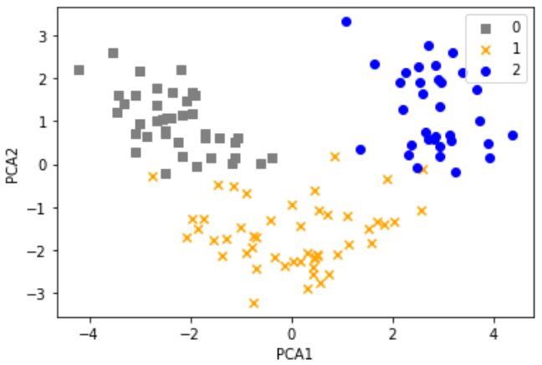
General concepts of ML
Q5: What is Principal Component Analysis (PCA)?
PCA is an unsupervised learning technique, useful when working with data of high dimensionality or for visualizing data.
Example: Common to combine PCA and clustering!

Slide 13
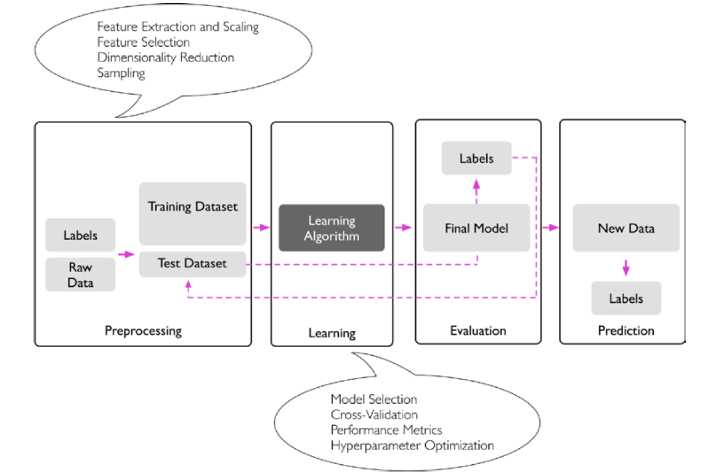
Roadmap for building ML systems
Q6: What is a typical workflow for using ML in predictive modeling?
Example: Introduction.ipynb (CI)
Image source: S. Raschka and V. Mirjalili, Python Machine Learning

Slide 14
Roadmap for building ML systems
Q7: Why do we need a train-test split? How do you evaluate prediction?
What is meant by generalization?
Image source: S. Raschka and V. Mirjalili, Python Machine Learning

Slide 15
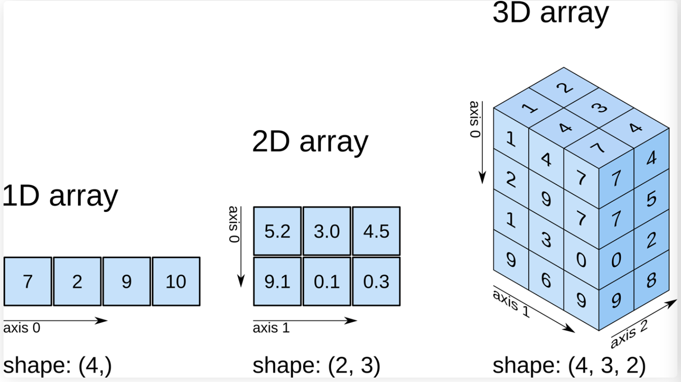
Review of Numpy arrays
API: https://numpy.org/doc/stable/reference/generated/numpy.array.html
Example: see Numpy_review.ipynb (students)

Slide 16
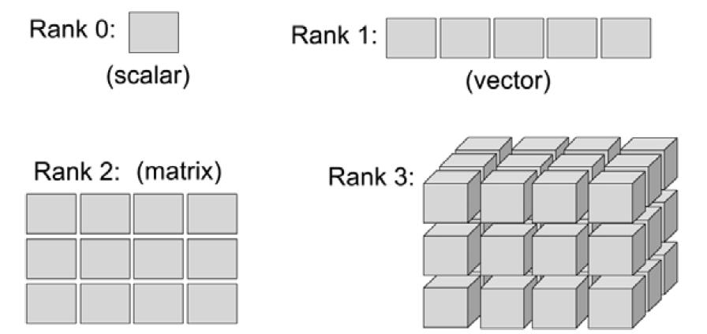
Introduction to TensorFlow
API: https://www.tensorflow.org/api_docs
Example: see TensorFlow_introduction.ipynb (students)
Image source: S. Raschka and V. Mirjalili, Python Machine Learning
[add a few notes about it here]

